Slide 1


Angular Applications with ASP.NET Core Part 1: Getting Started
Rick Strahl
West Wind Technologies
west-wind.com
weblog.west-wind.com
@RickStrahl
Session Materials:
https://github.com/RickStrahl/DI2017-AspNet-Core-Angular

Slide 2








About the Presenter
Rick Strahl
Big Kahuna @ West Wind Technologies
Author and Speaker
Popular Blog: weblog.west-wind.com
ASP.NET Insider and MVP
Tools and Components
@RickStrahl
rstrahl@west-wind.com
weblog.west-wind.com

Slide 3
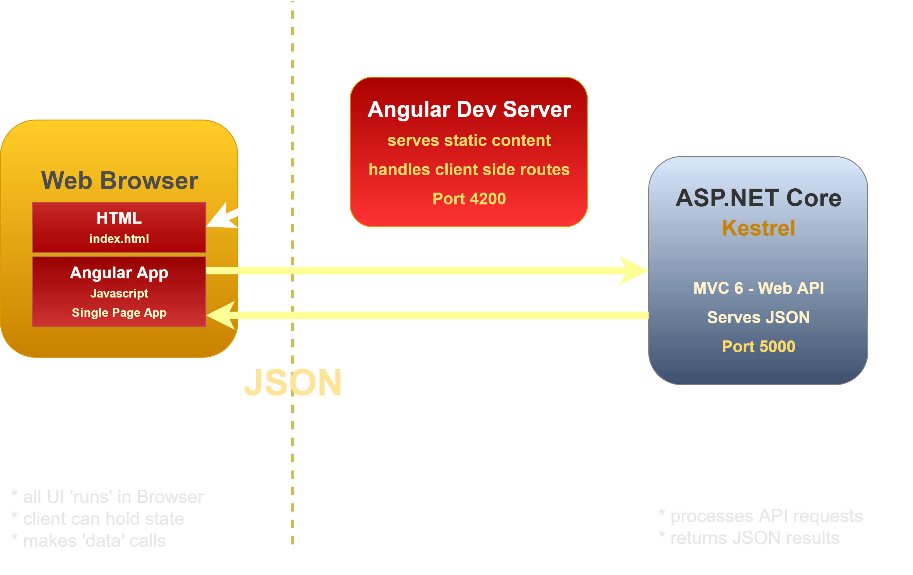


Angular and ASP.NET Core (dev)

Slide 4
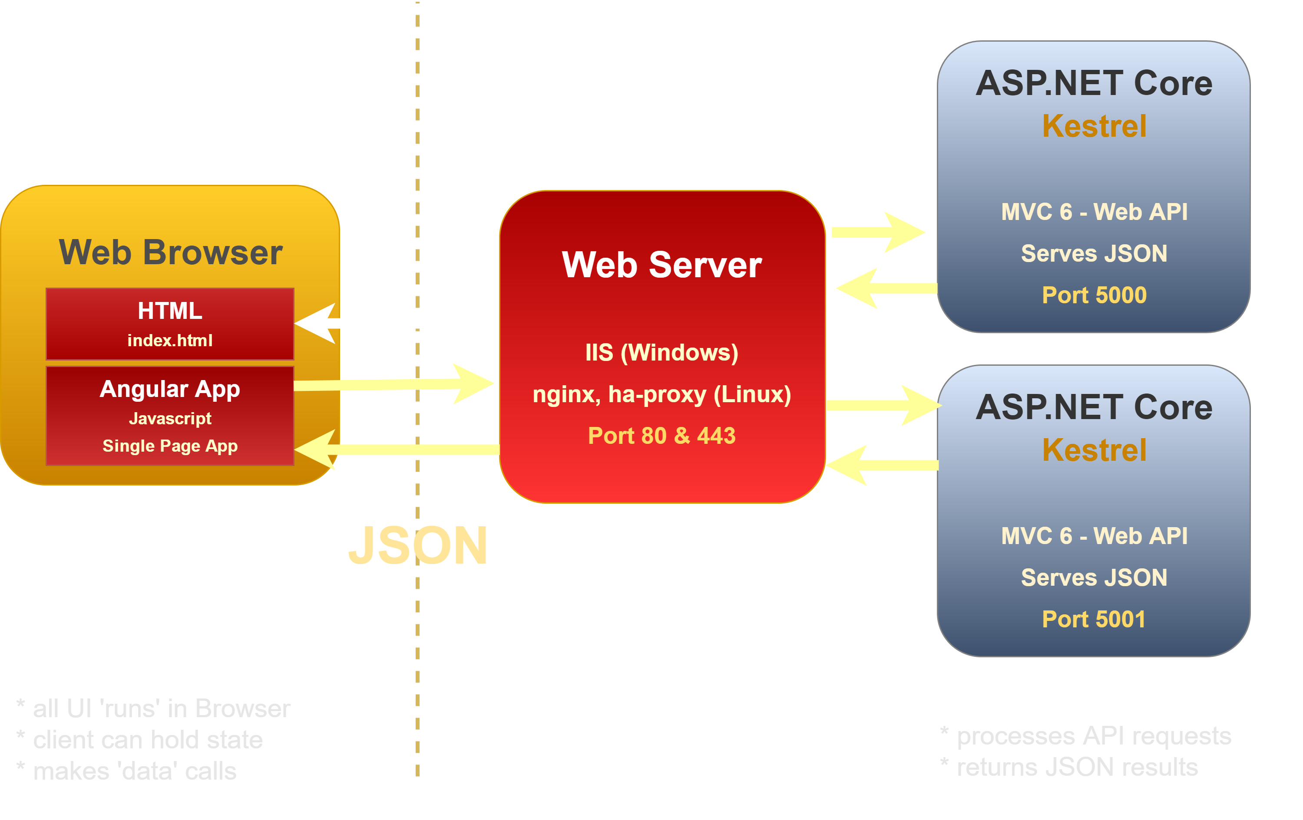


Angular and ASP.NET Core

Slide 5
What is Angular?
JavaScript Application Platform
Full featured framework for building SPA Applications
Not geared for use as a drop-in framework
Features
Simple Component Model w classes as components
HTML template binding
Client side MVVM
Module system (ES6/Typescript)
Fast, intuitive databinding
Reactive event system (rxJs)
Built-in HTTP support
Built-in Form Validation
Built-in Routing

Slide 6
Getting Started with Angular
Use the Angular CLI
Provides most dev/build features in one place
ng serve – run live reload web server
ng build – build production ready builds
ng generate – create new components/services
Don't get bogged down
Initially – JUST DO IT!
Create Components
Add Routes
Ignore the pile of tech involved
Pick up the tech as you go and need it
Rock on!
After initial tech overload Angular is very productive

Slide 7
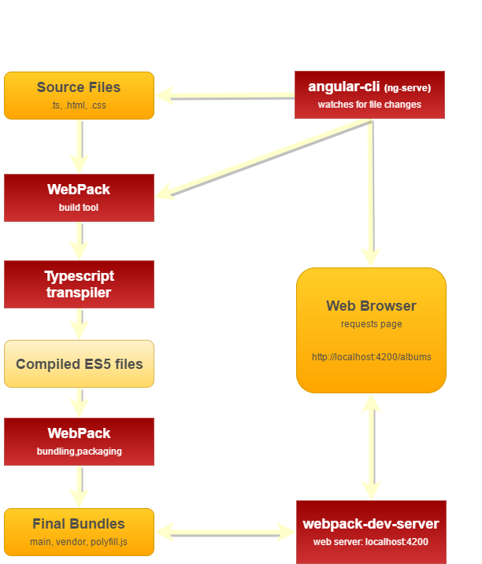
Angular/Typescript Build Process

Slide 8
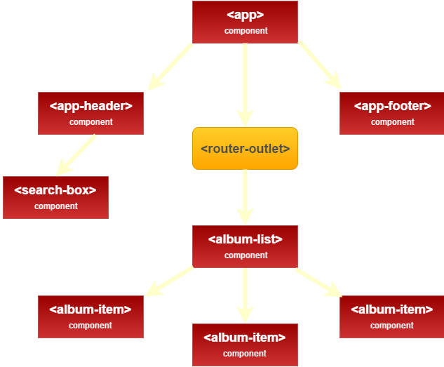
Angular Classes as Components

Slide 9
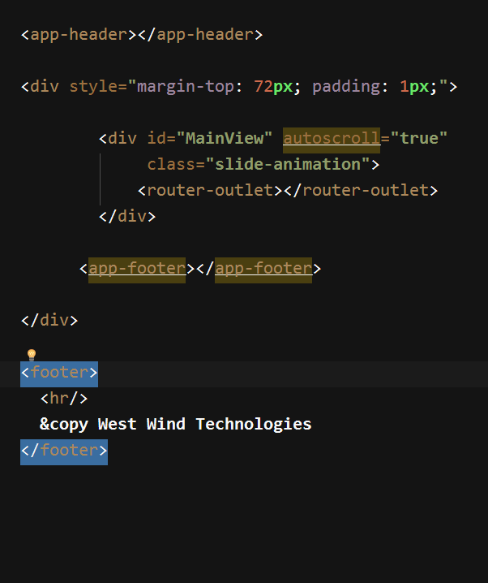
Top Level Composition
Component
View Outlets (router) renders a router view
Component

Slide 10
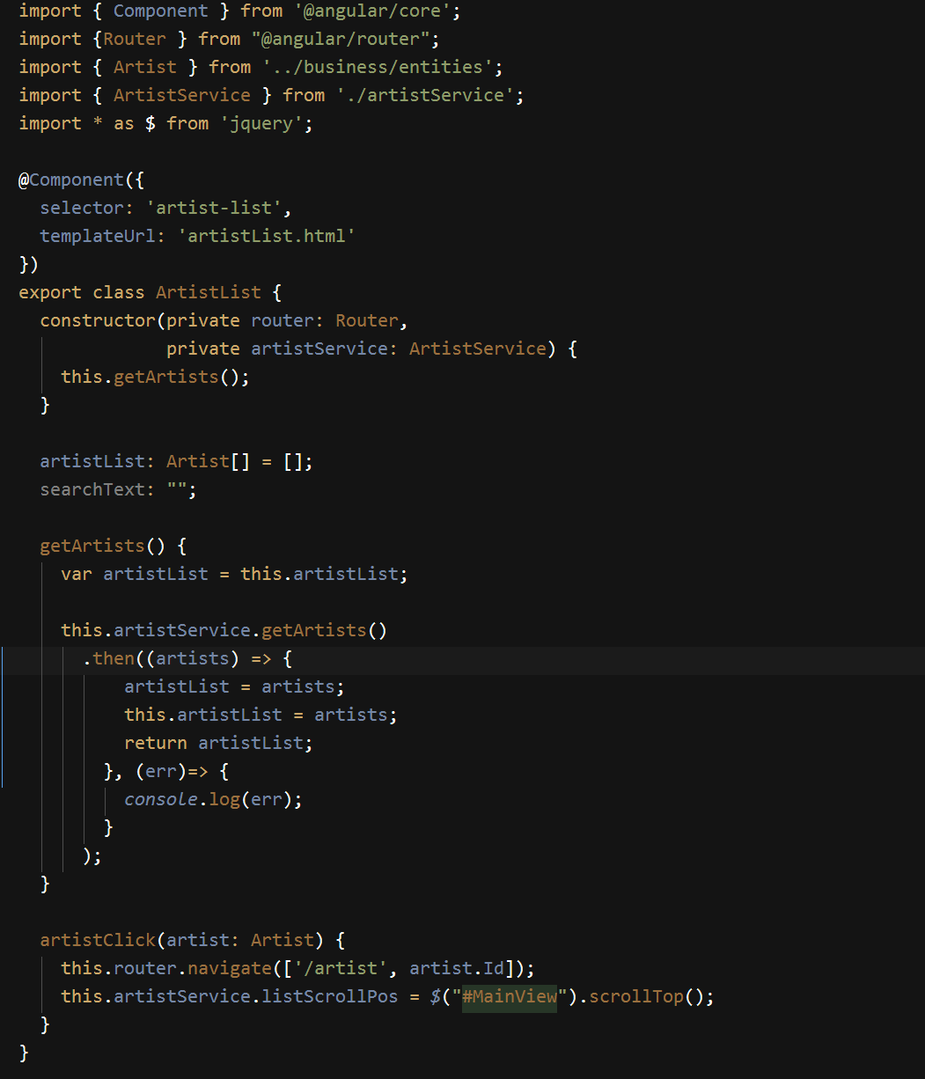
Typescript Classes as Components
Import dependencies
Component meta data
Class definition
dependencies are injected in ctor
Properties for model binding
Methods for event binding and logic

Slide 11
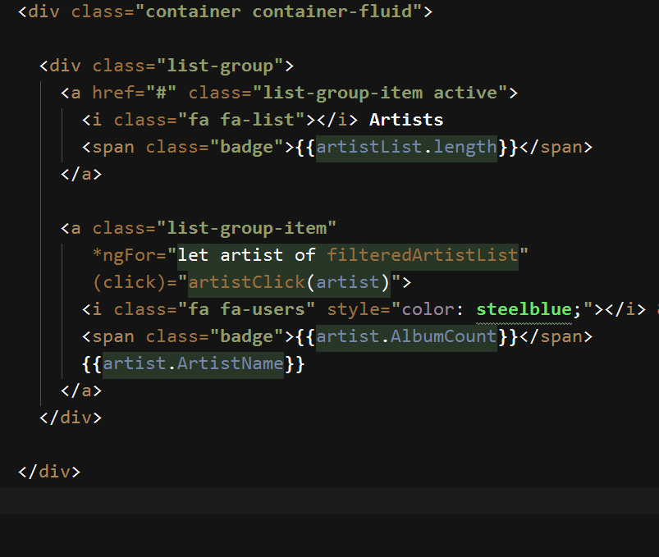
Html View
{{ Literal Bindings}}
*ngFor – looping component
(event) binding

Slide 12
Angular Component Templates
Databinding
HTML Markup with enhancements
Template tags: {{ expression }}
One way binding: [attribute]="expression"
Two way binding: [(ngModel)]="expression"
Event binding: (click)="method()"
Databinding works against any attribute and any event!
Directives
*ngIf – conditional rendering of element
*ngFor – loop construct
[ngClass] = "{selected: activeTab == 'options'}"
Form Validation
Use DOM validations
CSS Classes for state:
ng-valid,ng-invalid
ng-touched,ng-pristine
#form1="ngForm"
form1.invalid expression

Slide 13
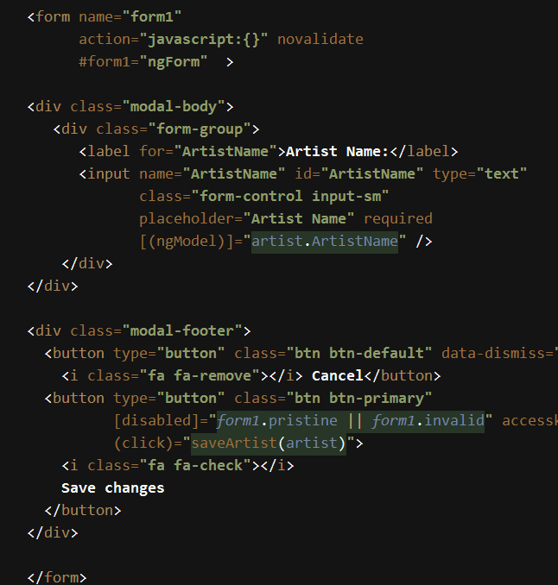
Databinding and Forms
Databinding
HTML Markup with enhancements
Template tags: {{ expression }}
One way binding: [attribute]="expression"
Two way binding: [(ngModel)]="expression"
Event binding: (click)="method()"
Databinding: any attribute and any event!
Directives
*ngIf – conditional rendering of element
*ngFor – loop construct
[ngClass] = "{selected: activeTab == 'options'}"
Form Validation
CSS Classes for state:
ng-valid,ng-invalid, ng-touched,ng-pristine
#form1="ngForm"
form1.invalid expression

Slide 14
ASP.NET Core for Apis
.NET goes cross platform

Slide 15
ASP.NET Core on the Server
Complete re-write of ASP.NET
High performance
Cross platform
Platform Independent
Windows, Linux, Mac
Works great on Docker
.NET Core Versioning
.NET Core 2.0 brings back sensible 'Runtimes'
Side by side support
Support for providing full runtime with application
High Performance
Kestrel Web Server (TechEmpower)
Lower memory usage than classic ASP.NET
More scalable for Cloud operation

Slide 16
ASP.NET Core Basic Concepts
Console Apps
Every .NET Core app is a Console app
Every ASP.NET app is a .NET Core (2.0) app
Hosting is self contained in Kestrel
Command Line Tooling
Build and Run is done through Command Line Tooling
dotnet new dotnet restore dotnet build dotnet run
Visual Studio and other tools use CLI tools
.NET Core 2.0 brings back 'Runtimes'
.NET Core Runtime or SDK needs to be installed
Results in smaller build folders and deployments
Runtimes can be referenced through build tooling
Full self-contained installs still work as well

Slide 17
The more things change…
… the more they stay the Same
Most ASP.NET MVC/API concepts remain
Most changes are in 'plumbing' and setup
Moving to .NET Core should be familiar for .NET devs
But not the Same
Configuration of ASP.NET is completely different
Everything is loaded through Dependency Injection
Lots of configuration details
But: Changes for the Better
New multi-target SDK Project Format
Modular pipeline – use only what you need
Dependency Injection for components
Proper middleware pipeline
Easier extensibility story

Slide 18
API Projects
API and MVC are now one Framework
Controllers can serve data (Api) or ActionResult (MVC)
Single base class, single set of filters
Simpler implementation than ASP.NET WebAPI
APIs – keep it simple
Objects in Objects out
Throw exceptions for errors
Use an error Filter to format errors
Error Handling
Throw Custom Exceptions for application/logic errors
Create a custom ExceptionFilter (custom ApiException)
Override OnException to always return JSON
Use a consistent error result for serialization (custom ApiError)

Slide 19
Angular 2.0 Summary
Powerful but Large Framework
End to end client side framework
Meant for full featured SPA applications
Not usable as a 'drop-in' framework
Modular JavaScript using TypeScript
DataBinding changes Everything!
Separation of code and DOM Manipulation
Model updates bind DOM values
Changes are real-time
Learning Curve
Initial learning curve is omnious
Actually building apps is easy through
Once you learn the 5 or so common concepts you can apply them for 90% of what you need to know
Google is your friend!

Slide 20
ASP.NET Core Summary
Framework
Light weight, high performance
Cross platform
Side by side .NET Runtimes and hot swapping support
Command Line Tooling
Build, publish, run with Command Line Tools
Every application is a self-hosted server application
Every application is a Console application
ASP.NET Core
A better ASP.NET
Integrated MVC and WebApi
Highly configurable Middleware Pipeline
Development
Fast applications – startup, execution
Slow build, run, debug cycle
Immature tooling

Slide 21

Thank you
Github Repo for Samples, Slides, Session Notes
https://github.com/RickStrahl/DI2017-AspNet-Core-Angular
Album Viewer Sample Application
https://github.com/RickStrahl/AlbumViewerVNext
Contact Rick:
weblog.west-wind.com
rstrahl@west-wind.com
west-wind.com/contact
@RickStrahl

